Slide 1
OS Server & Sistem Admin Final Project
</
/>
Ridha Nurrachmat
22.83.0857

Slide 2
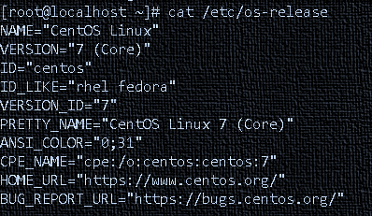
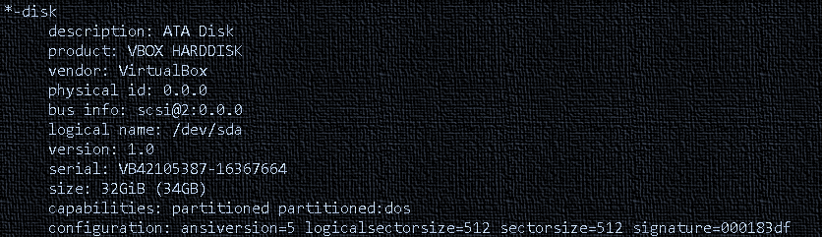
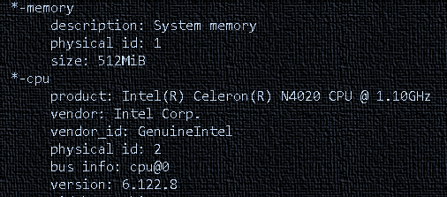
</About specification operating system CentOS 7
Operating system CentOS 7

Slide 3
</Server service that I gave on CentOS 7
Provide automatic IP addresses to connected clients
provides secure and private access by changing the connection path through the server.
DHCP Server
VPN Server
SSH Server
DNS Server
Used to securely access and manage remote systems
Functions to translate the IP address on the server into a domain name, making it easier for clients

Slide 4
</Thanks

